Slide 1
Customer Segmentation Problem (Data Science)
Submitted by:
Ravi Roushan Kumar

Slide 2

Project Overview
Past purchase data and customer data of a mall ultilised to segment customers into distinct groups.
2

Slide 3
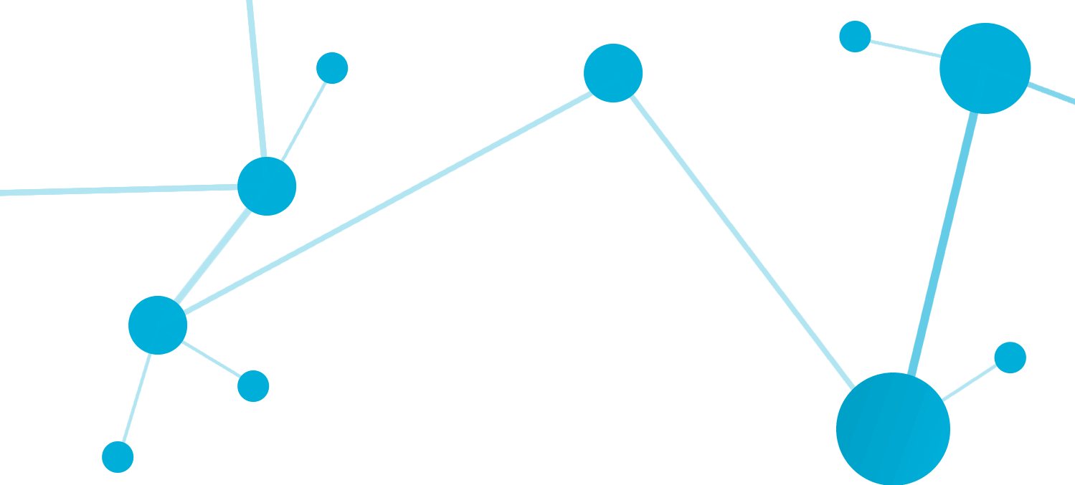
The Data
Customer ID: A unique ID to each customers of the Mall
Gender: Sex of the person to identify
Age: Age of the customer
Annual Income: Total yearly income of the customer
Spending Score: How much he spend in a year in the mall
3

Slide 4
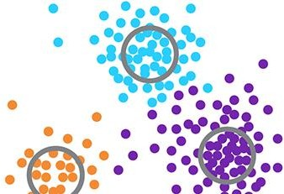
The Methodology
The project was treated as an unsupervised learning classification problem. Sklearn’s KMeans algorithms were utilized to build customer clusters. The Elbow Method was utilized to determine the appropriate number of clusters between two and twelve.
4

Slide 5
Data Wrangling
Date Fields: Required proper formatting
Missing Data: The handling of missing data was dependent upon the column
After viewing no missing data available in the columns so no action is being taken
Creation of Categorical Columns: Columns such as Gender that contained text were examined separately for the relation with other data.
Customer ID(Unused Column): Customer ID is unique for all so it has no use in data analysis.So we drop the column.
6

Slide 6

EDA Overview
Gender wise Classification: Count plot helps to see that female customers visit mal more than male.
Age: Age wise specification of data is than visualized.
Annual Income: Histogram to see the annual income by most of the peoples.
Spending Score: Histogram to see the spending score of most of the peoples.
Identified Outliers: Using boxplot to see is there any outlier in any category or not.
• Identify the benchmark for prediction (the percentage of days that the client currently achieves goal without)
• Analyzed data to identify trends
• Identified and subsequently removed outliers
• Explored the impact of marketing events on revenue

Slide 7
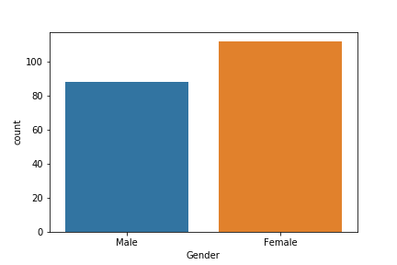
EDA: Male Female Count
Result: More Female customer than male customers.

Slide 8
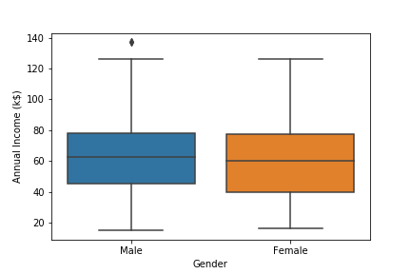
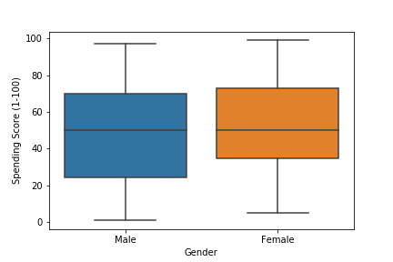
EDA: Box Plot
Annual Income for male has one outlier, while in spending score no outlier. Box plot is use to visualize percentile,

Slide 9
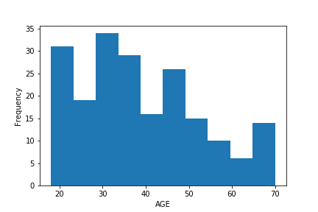
EDA: Histogram of Age
It is not a normal distribution. Age is skewed.
Younger people use to visit mall more than older people

Slide 10
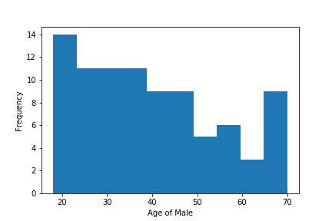
EDA: Histogram of Male Age
It is not a normal distribution. Age is skewed.
Younger Male use to visit mall more than older people

Slide 11
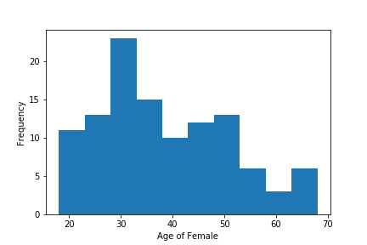
EDA: Histogram of Female Age
It is not a normal distribution. Age is skewed.
Younger female use to visit mall more than older people
Age 30 female use to visit mall more.

Slide 12
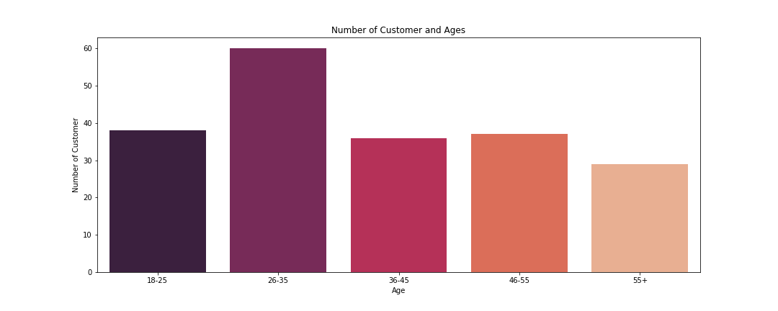
EDA: Bar Graph Age
Age 26-35 are the most number of customers that use to visit mall.
Age 55+ are the lowest.

Slide 13
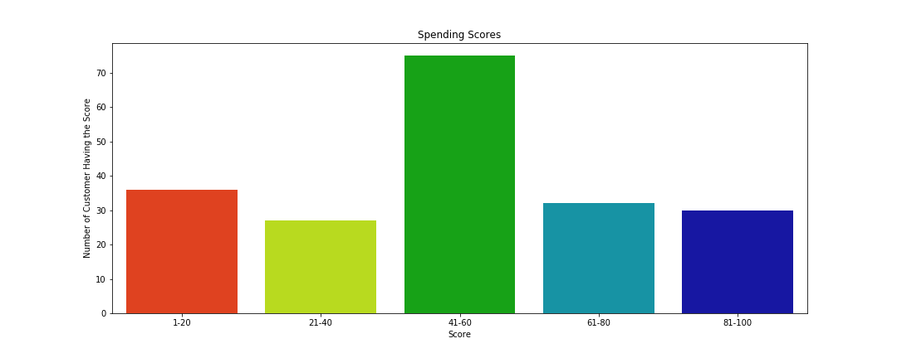
EDA: Bar Graph Spending Score
41-60 are the most spending score by customers in the mall.

Slide 14
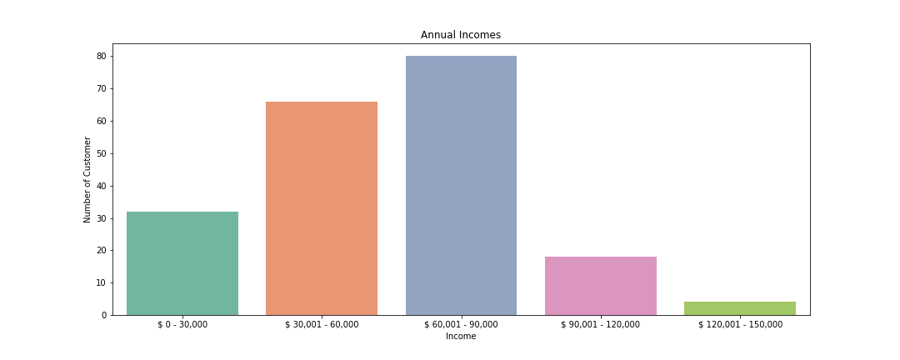
EDA: Bar Graph Annual Income
60-90 thousand dollar is the income of most of the peoples.
Very less people are there whose income is above 120000 dollar.

Slide 15
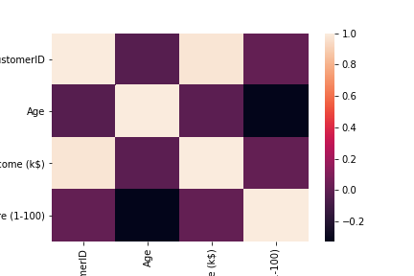
EDA: Heatmap
Correlation is viewed in a heatmap between all the indexes.
All of them have very low co relation, most of them have negative correlation.

Slide 16
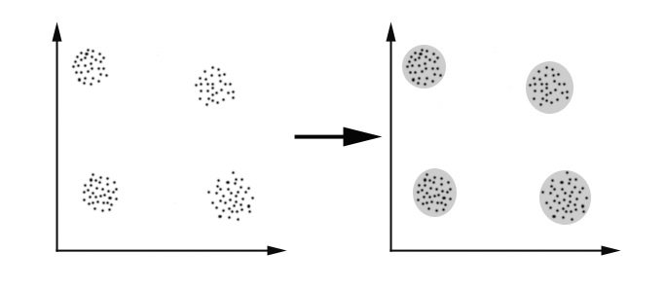
K Means Clustering
Unsupervised algorithm
K number of clusters are chosen apiary to divide into clusters based on elbow method.
Clusters are divided based on Euclidian or Hamiltonian distance.
Each cluster have similar property internally, and differs with other cluster.

Slide 17
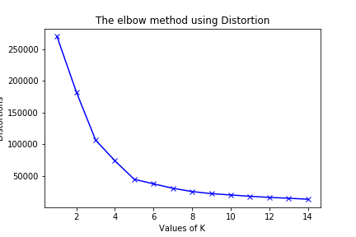
Clustering
The Elbow Method for Determining the Appropriate number of clusters.
As K increases, the centroids become closer to the cluster centroids and the improvements will begin to decline, in theory creating an elbow shape.
Top Graph: Avg. Within Cluster Sum of Squares
Bottom Graph: Distortion Number of Clusters Selected = 8

Slide 18
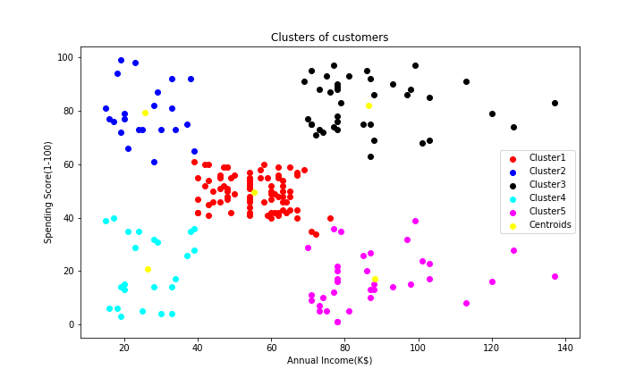
Clustering
After applying K means clustering on annual income vs spending score, customers are divide into 5 clusters with different properties
Centroids of each cluster is shown by different color.

Slide 19

Average Income average Spending (Cluster 1)
Middle class I’s middle level income peoples are in this group
Their spending in the mall is also limited I’s not high not low in the middle

Slide 20
Minimum income with high spending
(Cluster 2)
They are the poor people with lowest income range
But their spending is higher than the high income people, they use to visit mall frequently.

Slide 21

High Income and High Spending
(Cluster 3)
They are the richest people of the area
Their spending is also higher in mall ,so targeting these people will give benefits to mall.

Slide 22
Low Income and Low Spending
(Cluster 4)
They are the poor people, so they can not afford to spend more.
Their spending is also low at mall

Slide 23
High income but low spending
(Cluster 5)
They are the people with high income, but they don’t use to buy things from mall.
Better to do some research about them, so to attract these high income group.

Slide 24




Next Steps/Client Recommendations
Leverage customer segments to encourage desired behavior from current customers as well as to reach new, similar customers:
Align Creative with Customer Interests
Test Promotional Offers
Target Lapsed Customers
Retention Strategies
Survey Customers

Slide 25
THANK YOU

